Slide 1
JavaScript
program design and Useful Functions

Slide 2
Project: hangman
Learn a couple useful functions
Watch game (Hangman.html)
Flowchart main logic
Figure out spacing for underlines and letters (as letters are guessed)
Learn a few methods
Figure out spacing for hangman
Put it all together

Slide 3
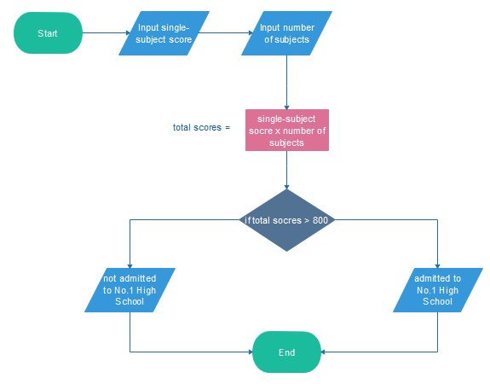
Flowchart Example #1
Am I Admitted to Preferred High School?
https://www.edrawsoft.com/flowchart-examples-for-students.php

Slide 4
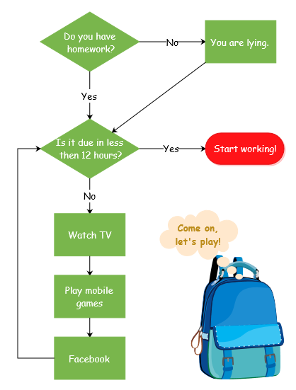
Flowchart Example #2
Should I do my homework now?

Slide 5
Flowchart symbols
Terminator. starting or ending point of the system.
Process. A box indicates some particular operation
Input-Output. Get entry from user, display message. Could just use process for this, for simplicity.
Decision. A diamond represents a decision or branching point. Lines coming out from the diamond indicates different possible situations, leading to different sub-processes.
https://www.visual-paradigm.com/tutorials/flowchart-tutorial/

Slide 6
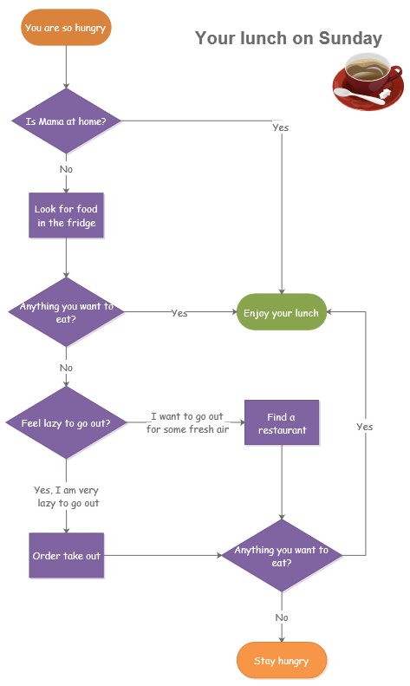
Flowchart example #3
What should I eat for lunch?

Slide 7
Try it – with a partner
Watch the game
Draw a flowchart for the main program logic
Select the word, get a guess, etc.
Flowchart does not contain JavaScript syntax. For example, you might have a process box that says Select Word. This will use a math function named random … but that’s unnecessary detail for the flowchart.
Just use one process box for drawing the hangman
We will do more design on hangman drawing soon
Pedagogy sidebar.
You can provide a flowchart OR ask students to do it
Best to use flowcharts for complex processes (just boring for routine tasks)
There are automated tools (e.g., Dia) that streamline the process.

Slide 8
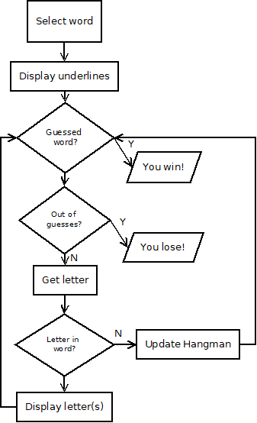
Hangman flowchart
Pedagogy sidebar: Flowcharts can be more detailed, such as specifying how variables should be updated. But this is often more tedious than helpful.
Flowchart can help you identify tasks you don’t know how to code. What have you not yet learned??

Slide 9
Random
Games often rely on random behavior (shuffling cards, rolling die, etc.)
Computer generates pseudo-random numbers (digital code is not like a coin toss, but can appear so)
Math.random();
Generates a number from [0, 1)
Includes 0, excludes 1
To get number from 0 to 9:
Math.floor(Math.random() * 10);
Floor example. Assume 0.28 is generated.
0.28*10 = 2.8. But we want integer values.
Floor truncates, becomes 2.
What other numbers become 2?
Common: use random to select array location
Math.floor(Math.random() * words.length);
Pedagogy sidebar: examples clarify how functions work. English descriptions can be confusing.
https://www.w3schools.com/js/js_random.asp

Slide 10
prompt
var person = prompt("Please enter your name", "Harry Potter"); if (person == null || person == "") { txt = "User cancelled input."; } else { txt = "Hello " + person +
"! How are you today?"; }
Causes a pop-up box to appear
Clunky way to input, but easy to learn
Data is often input via forms. Common in business, but beyond our scope.
https://www.w3schools.com/js/js_popup.asp

Slide 11
while loop
Sometimes we want to continue an action until a certain condition is true
// continues previous example
while (ticketsRemaining > 0) {
var tickets =
prompt("Buy how many tickets?");
if (tickets != null && tickets != "") {
ticketsRemaining -= tickets;
}
console.log(ticketsRemaining);
}
// actions AFTER the loop ends
alert("No more tickets!");
Pedagogy sidebar: Common mistake is to not update the variables involved in the condition. To debug, put console.log statements inside the loop to help you see how the values are changing.

Slide 12
while with Boolean var
Condition for while loop to continue is a Boolean (true/false)
Can be evaluated statement (tickets < 100)
Can also be a variable with a Boolean value
If keepGoing is true, !keepGoing is false (sometimes conditions are easier to express/test this way, such as !gameOver)
var keepGoing = true;
var number = Math.floor(Math.random()*10);
var numGuesses = 0;
while (keepGoing) {
var guess = prompt("Guess the number");
if (guess != null && guess != "") {
if (guess == number) {
alert("That's right!");
keepGoing = false;
} else if (numGuesses >= 3) {
alert("Too bad, you didn't guess");
keepGoing = false;
}
}
numGuesses++;
}
Pedagogy sidebar: how similar should the example be to the assignment? For first lessons, very similar. As students gain experience, increase challenge by providing examples that need more modifications.

Slide 13
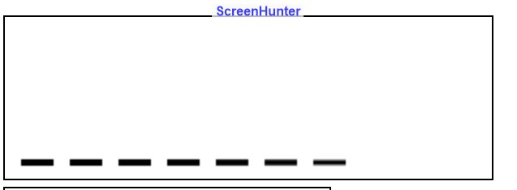
Underline spacing
Goal: display the correct # of underlines based on the selected word
Challenge: the underlines will be drawn (using JS commands we already learned). We need to figure out x and y coordinates so spacing is reasonable.
Will appear on screen as:
margin|line|margin|line|margin|line
Size assumptions:
margin (space before/between lines) is 10
line length is 20 (twice as much as margin)
Does the y value change?
How does the x value change each time?
Letter (ix) | start x | end x
0 | 10 | 30
1 | 40 | 60
2 | 70 | 90
Pedagogy sidebar: coding SPEED is based on knowing what you want to do and how to do it! Trial and error is SLOW.
Some students are analytical thinkers, may not need examples. Many/most students will benefit from this technique.

Slide 14
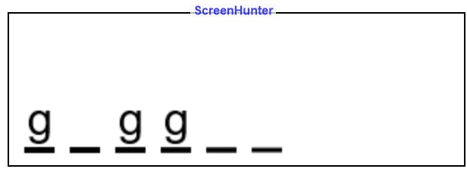
letter spacing
Goal: display the guessed letters
JS command: ctx.fillText(letter, x, y);
Each letter should be indented slightly from its underline
A formula for this will likely be cleaner than lots of additions
Technique:
write out the first few examples (2-3 is often useful to see the pattern)
Convert the pattern to a formula
Size assumptions:
margin (space before/between lines) is 10, line length is 20 (2*margin)
indent (from start of line to start of letter) is 2
y is constant again, but needs to be above line (see descenders in image)
ix | X |  | formula
0 | 12 | margin+indent | (ix+1)*margin + indent
1 | 42 | margin+line+margin+indent | (ix+1)*margin + ix * line length + indent
2 | 62 | margin+line+margin+line+indent | same as above
Do we need a different formula for first letter?

Slide 15
letter in word?
Everyone knows how to google
BUT some queries are more effective than others
Be specific and concise about goal
Include language (i.e., JavaScript)
The first answer is not always the best
Built-in commands are preferred (if JS has a function that does what you need, use it!)
jQuery is a popular JS library. It’s very useful for professionals, but you will probably want to avoid it (has lots of power but also a learning curve)
Some solutions will use “regular expressions” which are also powerful but even more learning curve
Example queries:
JavaScript draw text canvas
JavaScript is letter in word
yields a number home-grown solutions
JavaScript string functions
https://www.w3schools.com/jsref/jsref_indexof.asp
As with other aspects of programming, your skill with this will increase over time. The “best” programmers are often just the most persistent. Tell your girls this! (and your boys, too)

Slide 16
Time to program
Create a version of the game that does everything EXCEPT draw the hangman
For ease of testing, after the word is selected, use an alert to show it
HangmanPlay.html
Let me know when you’re done and we’ll talk about the next step

Slide 17
more design
Need to design the hangman
Note that this could be done before or after game play
HangmanDrawing.html

Slide 18
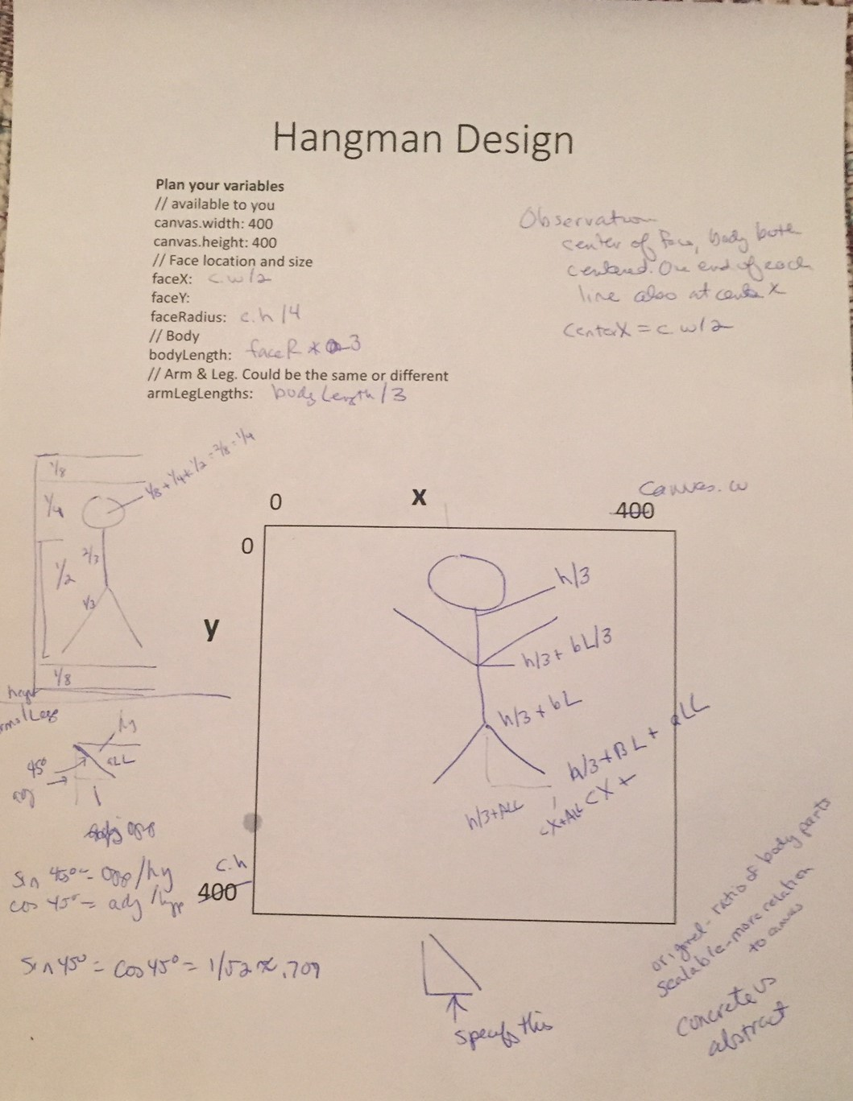
modeling
It’s good to show students that sometimes you have to think/struggle (i.e., don’t present everything in finished form, show the false starts)
If you like a student’s idea better than yours, adopt it (and give credit)

Slide 19
continue programming
If this is brand new and too fast/confusing, I can revisit with individuals/small groups tomorrow.
If concepts are good but it will take more time, this might be your post work.
If you’re done or almost done – KUDOS!

Slide 20
End of day 2
Stick around for broadening participation in computing

